Slide 1
Project 1 (Frequency Estimation of Complex Exponential Signals in Noise)
Presented by-
Nitheesh Kumar Manjunath
Hasib-Al-Rashid
Saurin Shah

Slide 2
Introduction
Task:
To develop an algorithm for estimating the frequency of a complex exponential signal in additive white gaussian noise.
Requirements:
The frequency of a complex exponential signal is measured within 30 Hz root mean square (rms) error at a signal to noise ratio (SNR) of 5 dB.
To test the first requirement, we used just one complex exponential but with only 32 dB of SNR. Then we run our algorithm multiple of times (ex. 5000) adding a different noise vector on each iteration and measure the frequency estimate of our algorithm. So we calculated the RMS with all the multiple frequencies. The rms should be less than 30 Hz.
Two equally-powered signals at 20 dB SNR is resolvable to 200 Hz. The frequency difference measurement shall be less than 20 Hz rms.
The second requirement requires two complex exponential's at 20 dB. Our algorithm detected both frequencies.

Slide 3
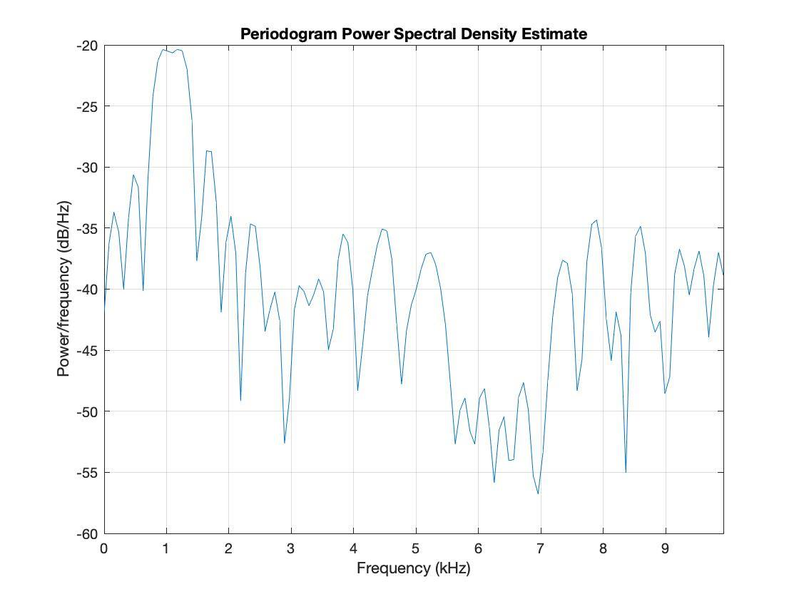
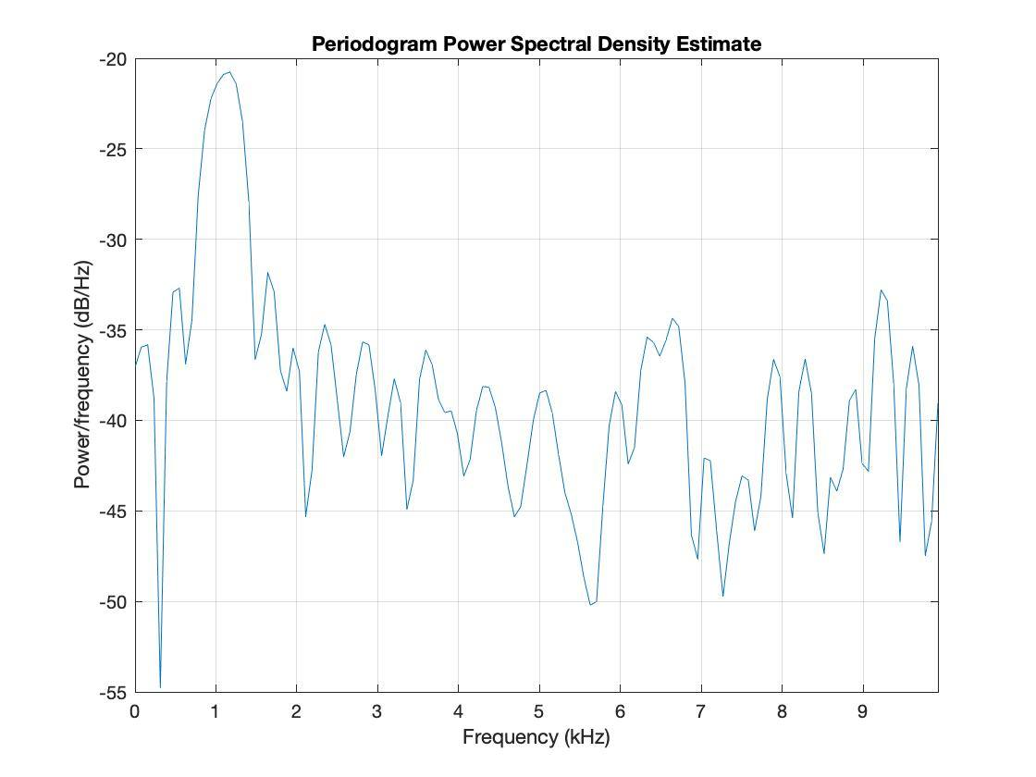
Other Algorithms

Slide 4
Block Diagram
Design of Algorithm
Correlation Matrix
Pmusic
Max values of the peaks
Collect Signal Data from correlation matrix, R
Calculate eigen structure of R in a metric
Decide no. of signals (P)
Evaluate Pseudospectrum (S) vs. frequencies (F)
Pick P peaks
Signals and Noise
Taking RMS values and plotting

Slide 5
Design of Algorithm
Reasons to chose MUSIC algorithm in our algorithm
MUSIC algorithm (Pmusic) does not take any assumption so it is more accurate than other frequency estimation methods
MUSIC algorithm (Pmusic) provides higher resolution than other frequency estimation methods

Slide 6
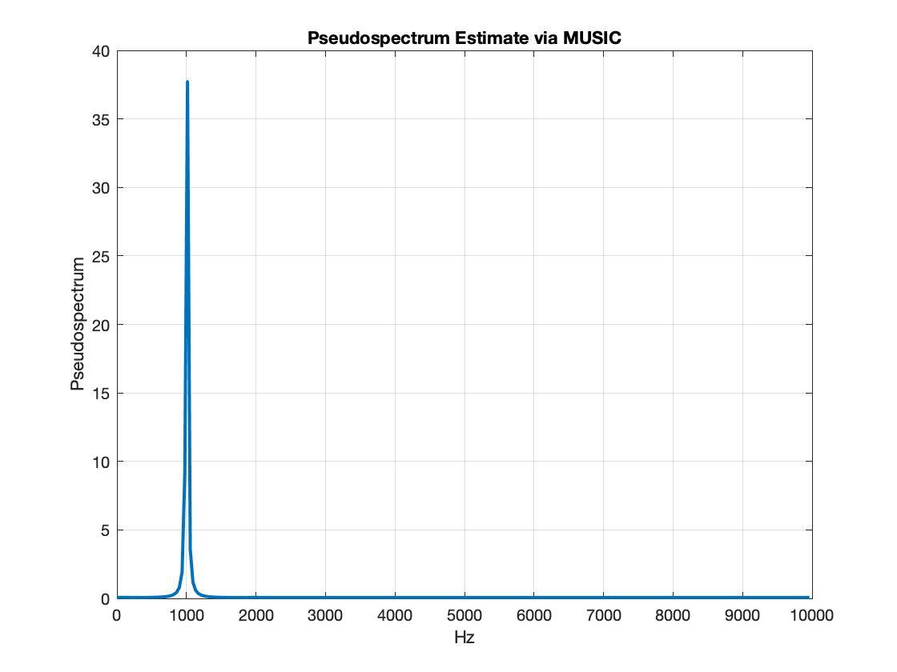
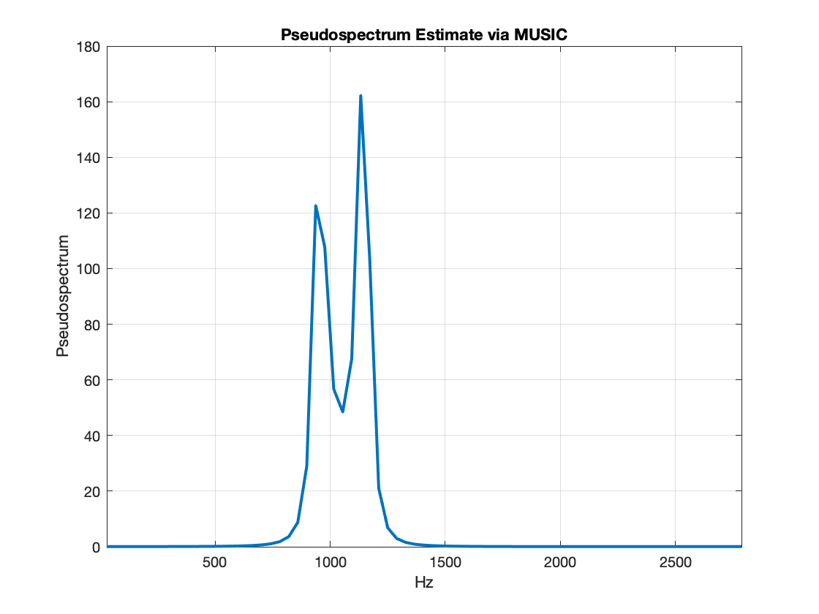
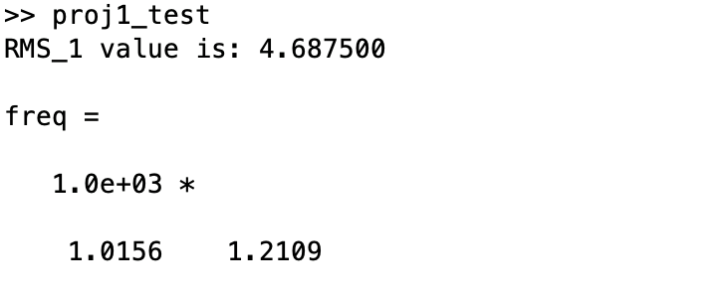
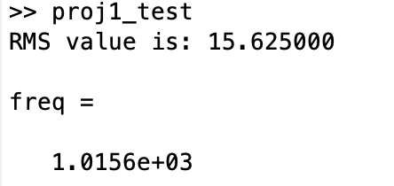
Results
Fig(1) : Frequency Estimation for requirement 1
Fig(2) : Frequency Estimation for requirement 2

Slide 7
Summary
Completeness:
The result of the project presents the completeness of the required tasks.
Discussion:
Due to lack of time and complete understanding of the full music algorithm, we could not help but using pre-defined MATLAB function pmusic( ).
We learned how to get the estimation of frequencies mixed with random noises. Different estimation techniques are available but MUSIC algorithm is precise than other popular algorithms i.e FFT or Burg’s Algorithms.

Slide 8
Thank You

